Slide 1


DESIGNER AND PRESENTER FOR MEDIA-AUGMENTED PRINTED MATERIAL WITH MOBILE DEVICES
UNIVERSITY OF NATURAL SCIENCE
ADVANCED PROGRAM IN COMPUTER SCIENCE
Thesis advisor :
DR. TRAN MINH TRIET
Students :
PHAM NGOC TRUC - 0612750
NGUYEN KHANH THUAN - 0612729

Slide 2
Outline
Introduction to
Augmented Reality (AR)
Theoretical Background
AR Designer & Presenter Module
Conclusion & Future Work

Slide 3
Introduction to Augmented Reality (AR)

Slide 4
Augmented Reality
In [5], Azuma defines it as a derivation from virtual reality “Augmented Reality (AR) is a variation of Virtual Environments (VE), or Virtual Reality as it is more commonly called.
Real World + Digital World = Augmented Real World

Slide 5
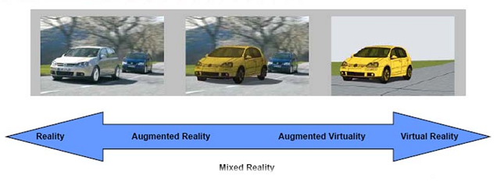
Augmented Reality (cont)
Augment the real world
(Source: Introduce Augmented Reality and its application, Siggraph Asia 2010)

Slide 6
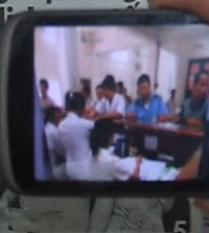
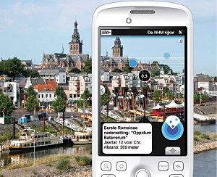
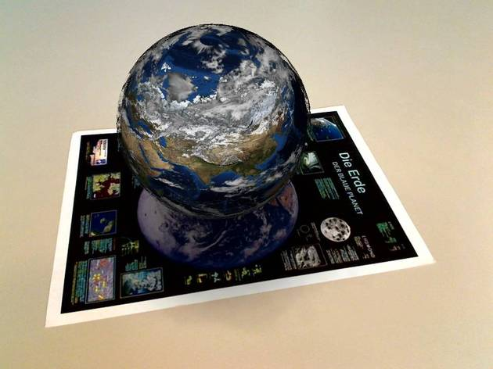
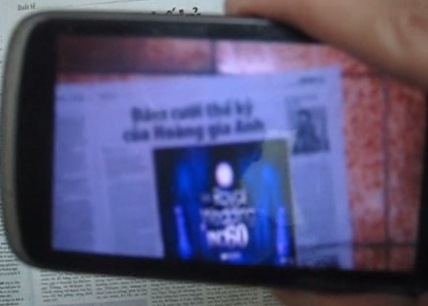
Augmented information
Text
Image
...
3D Model
Video/ Audio
Combination

Slide 7
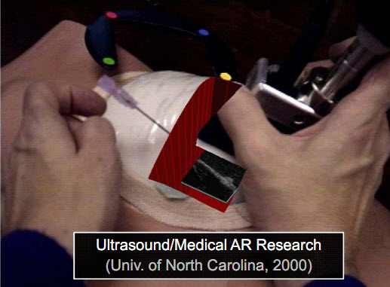
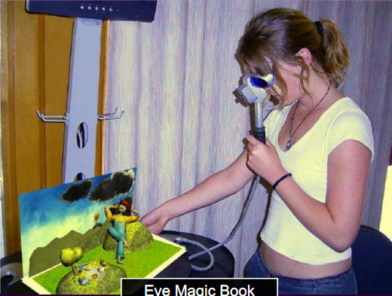
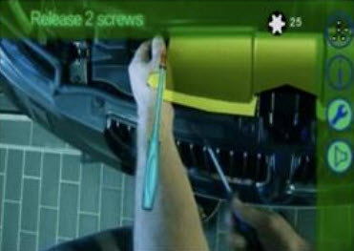
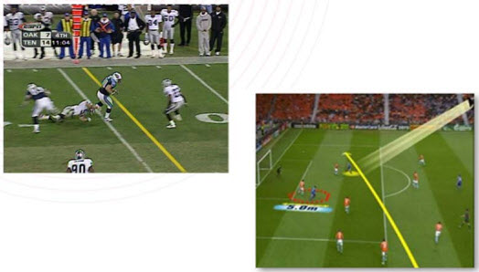
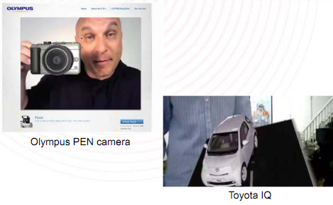
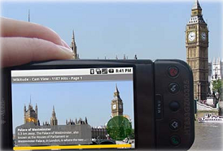
AR applications
Healthcare
Education
Production
Multimedia
Advertisement
Mobile contexts
(Introduce Augmented Reality and its application, Siggraph Asia 2010)

Slide 8
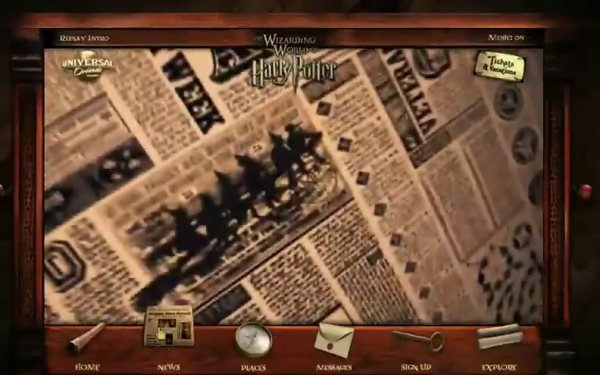
Augmented Newspaper Idea
Harry Potter film’s Newspaper
(source: http://wizardingworldpark.com)

Slide 9
Objectives
-Support dynamic mechanism with plugin technique.
-Create the GUI easily to be customized.
Support real-time execution on Android mobile.

Slide 10
Theoretical Background

Slide 11
AR application platform
The platform of our choice is QCAR SDK
This tool is already widely used to create AR applications for many platforms, especially mobile devices.
The type of markers defined and used in QCAR SDK is optimized to be more user-friendly.

Slide 12
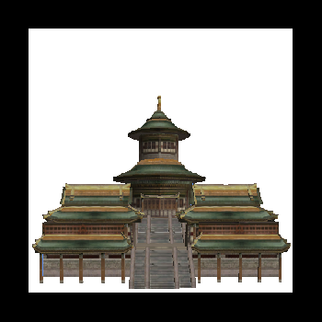

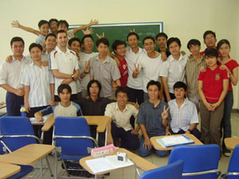
Define markers
ARToolkitPlus:
User-defined marker
System ID-Marker
QCAR SDK:
Image Targets
Notes:
Có 2 loại mẫu, mẫu do người dùng định nghĩa và mẫu do hệ thống định nghĩa sẵn

Slide 13
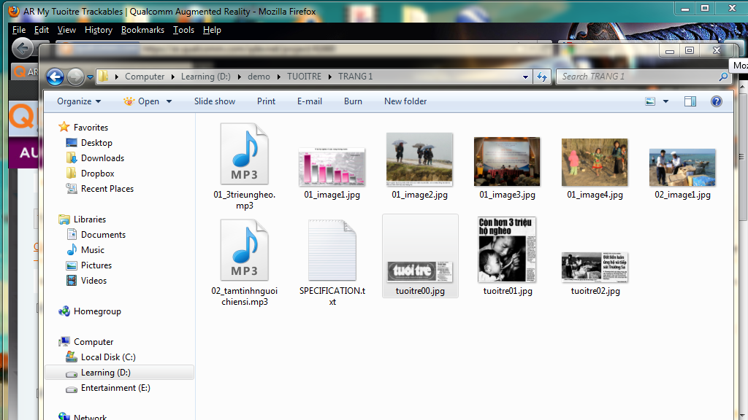
Download resource

Slide 14
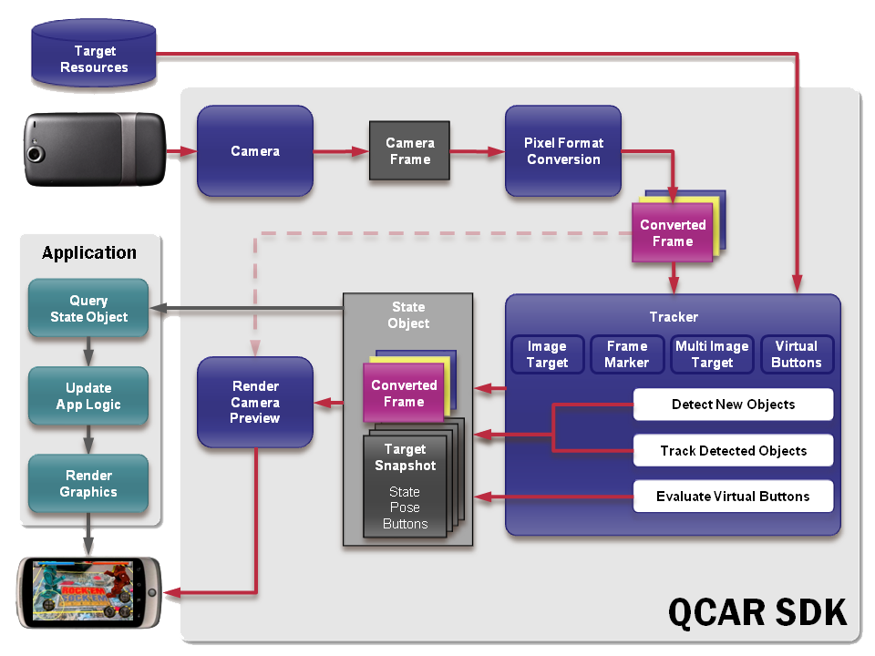
Process of a QCAR-based AR application
(source: https://ar.qualcomm.com)
Notes:
Quy trình xử lý của 1 ứng dụng thực tại bao gồm 2 công đoạn chính: Nhận dạng mẫu và hiển thị thông tin tăng cường
Các mẫu dùng để nhận dạng thường có hình vuông và có viền đen bao quanh. Các mẫu này người ta thường gọi là marker.
Các thông tin tăng cường thì được hiển thị dưới dạng mô hình 3 chiều

Slide 15
AR Designer & Presenter Module

Slide 16
System Overview
Desktop
Mobile
AR Designer
Project 1
AR Presenter
Project 2
Object
Marker
Object
GUI
Project n
Data
Config
Data
Config
Android SDK
QCAR SDK
Plugin
Config file
.NET Framework 3.5
Android Platform
Media files
Hardware (camera)
Hardware (computer)

Slide 17
AR Designer
XML file
AR Designer
Auto Generate
Load
XML Generator
AR Media Objects
Interact
Audio
3D Object
Video
Image
AR Interface Designer
Sequence of Images
AR Newspaper Editor
AR Media Objects Loader

Slide 18
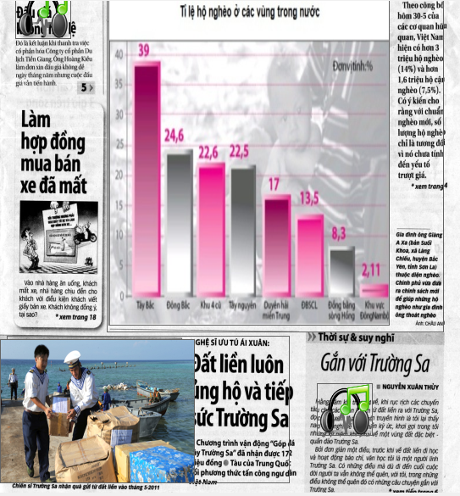
Marker vs Objects

Slide 19
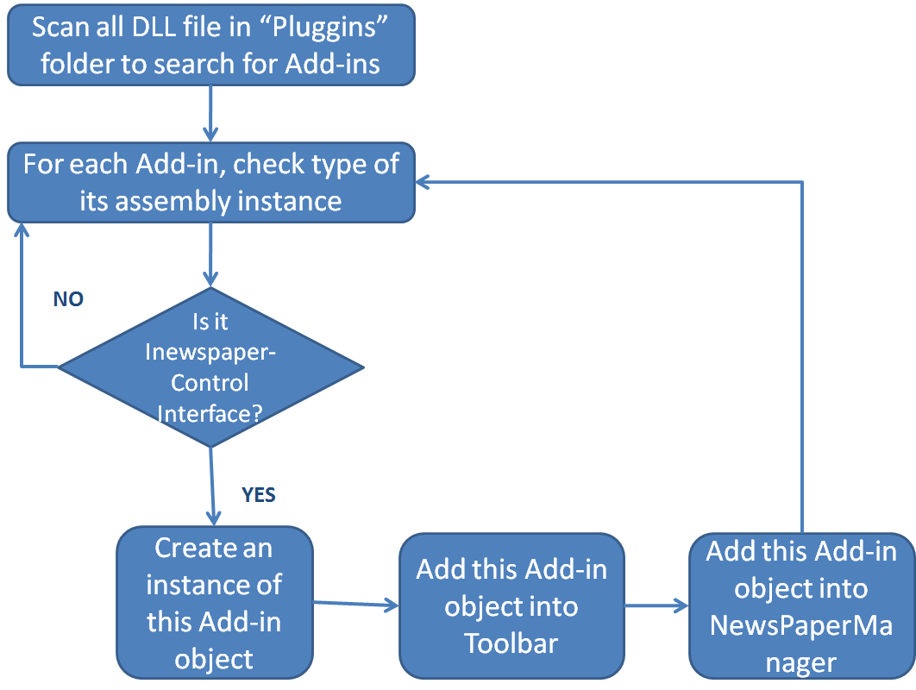
Plugin Technique

Slide 20
Media Objects
ARObject
ARText
ARImage
ARVideo
AR3DModel
ARSeqImages

Slide 21
Demonstration
How to design simple a newspaper.
How to add more control plugin.
How to load, and edit an existing newspaper.

Slide 22
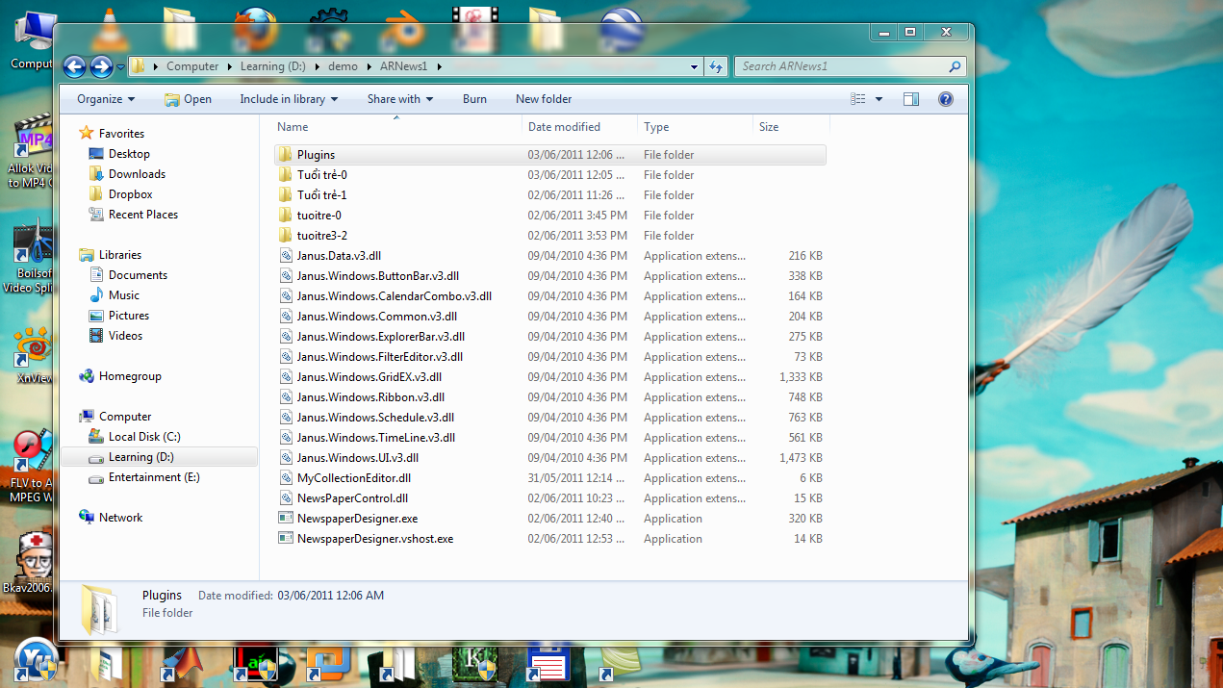
How to design simple a newspaper

Slide 23
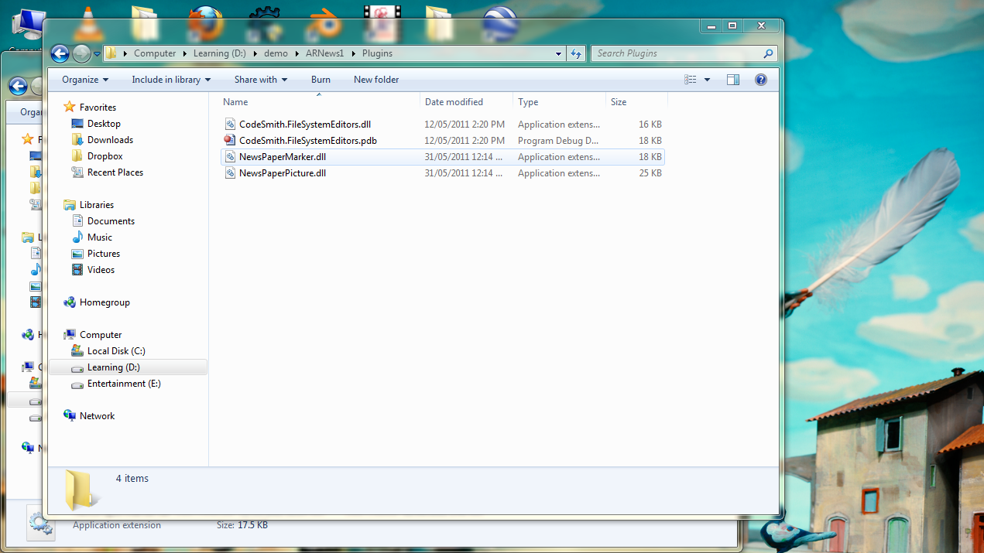
How to add more control plugin.

Slide 24
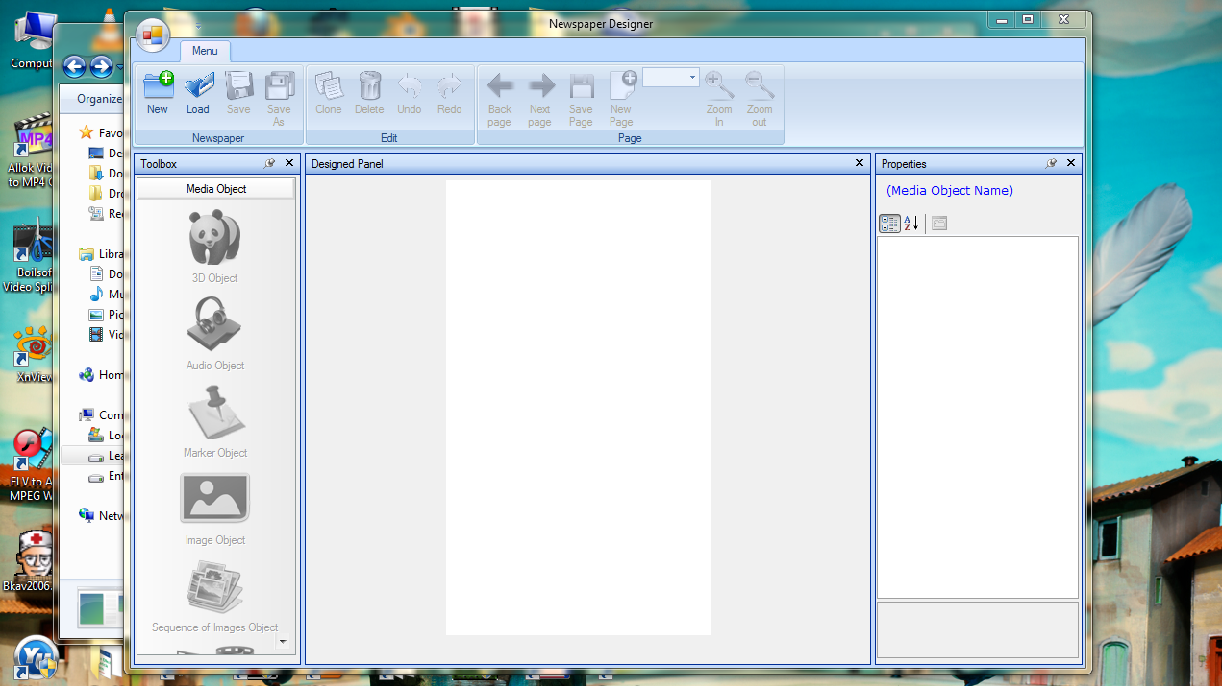
How to load, and edit an existing newspaper.

Slide 25
AR Presenter
Parsing module
Read
XML file
Trackerr
Interact
Interact
Download module
Info
Objects management
System
Set & Get
Audio
3D Object
Interact
Video
Image
Sequence of Images
Display module

Slide 26
AR Presenter
Tracker provides information of markers in the scene
Retrieve and parse XML information to store data of objects
Render objects on screen

Slide 27
Demonstration
Thanh Nien Newspaper
Tuoi Tre Newspaper
English textbook for eight grade

Slide 28
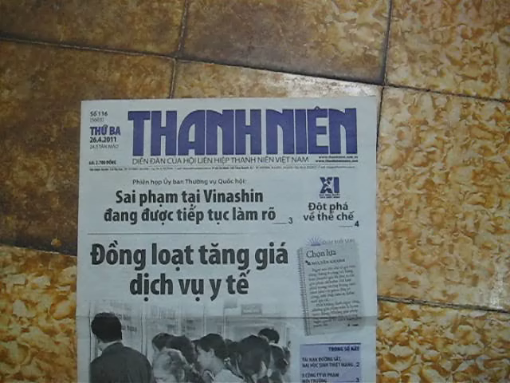
Thanh Nien Newspaper

Slide 29
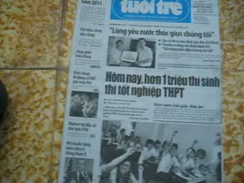
Tuoi Tre Newspaper

Slide 30
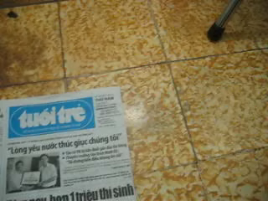
Tuoi Tre Newspaper (cont)

Slide 31
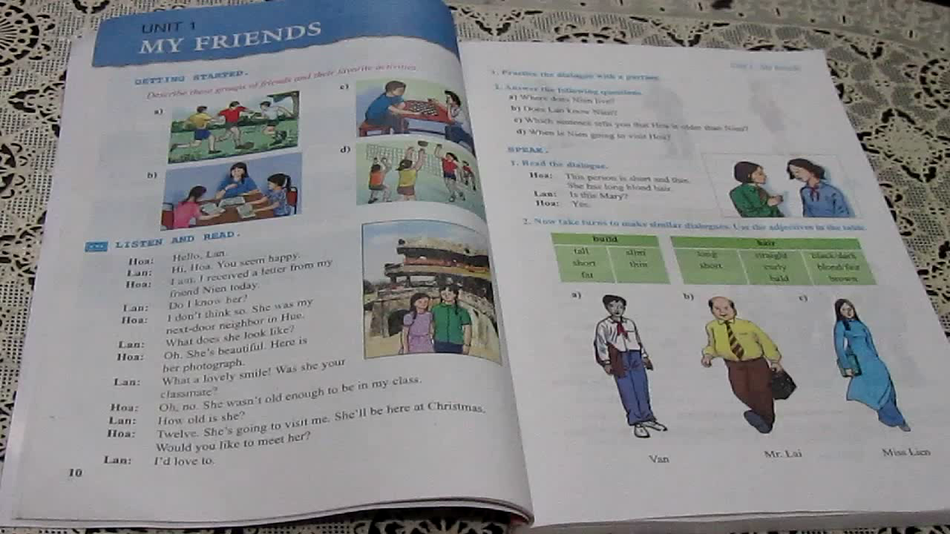
English textbook for eight grade

Slide 32
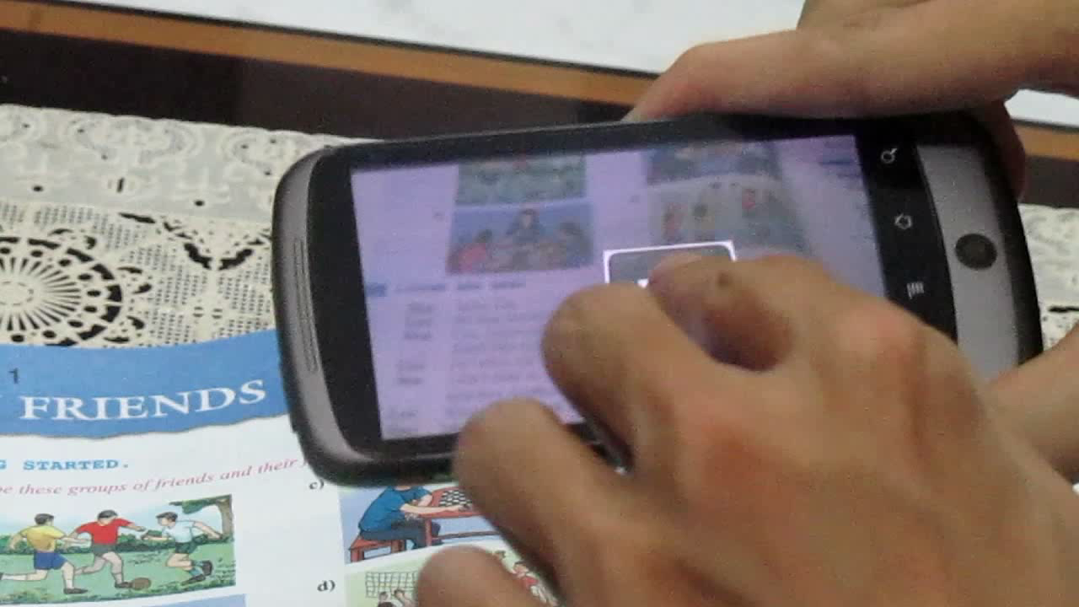
English textbook for eight grade (cont)

Slide 33
Conclusion & Future Work

Slide 34
Conclusion
The overall system can augmented almost printed material.
It also run smoothly and supports a lot of Android mobile devices.
The architecture is open, (add more media object easily, or use additional libraries…)

Slide 35
Future work
Enhance quality of each media object.
Erase the seam between augmented object and real object.
Download from host (deliverable).

Slide 36
Credit
In our thesis, we use the information from manysources, including :
- Tuoi Tre Newspaper (online & printed version)
- Thanh Nien Newspaper ( online version)
- The English text book and associated audio for Eight grade (Vietnam).
- Video clips obtained from www.youtube.com
…

Slide 37

Thank you for your attention
University of Science Advance Program in Computer Science

